Slide 1

MiKuri Game Project
Project Producers:
Mohammad Murad Chamaa
Juan Diego Ron Molina

Slide 2
Parts
1) Purpose of Creating the Game
2) Scope of the Game
3) Technologies Used
4) Architecture of the Game
5) Technical Structure and Working Logic of the Game
6) Places Where Object Oriented Programming Feature is Used
7) Difficulties Experienced and Solutions
8) Results and Recommendations

Slide 3

Purpose of Creating the Game
One of the most important features of the Java programming language is undoubtedly the Object Oriented Programming feature.
Except for Minecraft, the Java language is no longer used in today's gaming industry. That's why we decided to make a game, because there are multiple objects in games.
The main idea behind this project is to examine why Java is not widely used in the gaming industry today by making a game using Java.

Slide 4

2) Scope of the Game
The main idea of ​​the game is that mini monsters fight each other.
Java, JavaFX and SceneBuilder technologies were used to make this game. In addition, 9 different classes, 2 different abstract classes, 3 interfaces, 1 Exception, 5 FXML files, photos for the background and monsters, and finally music were used in this project.
While Murad was mainly involved in the production of the login screen and in-game screen of this project, Juan was mainly involved in the production of the loading screens and in-game mechanics.

Slide 5



3) Technologies Used
Java Programming Language
JavaFX Library: It is one of the most important libraries used to create games.
SceneBuilder Application: It allows us to edit the FXML files that the JavaFX library uses as an interface, with the help of an interface instead of editing them by coding.

Slide 6
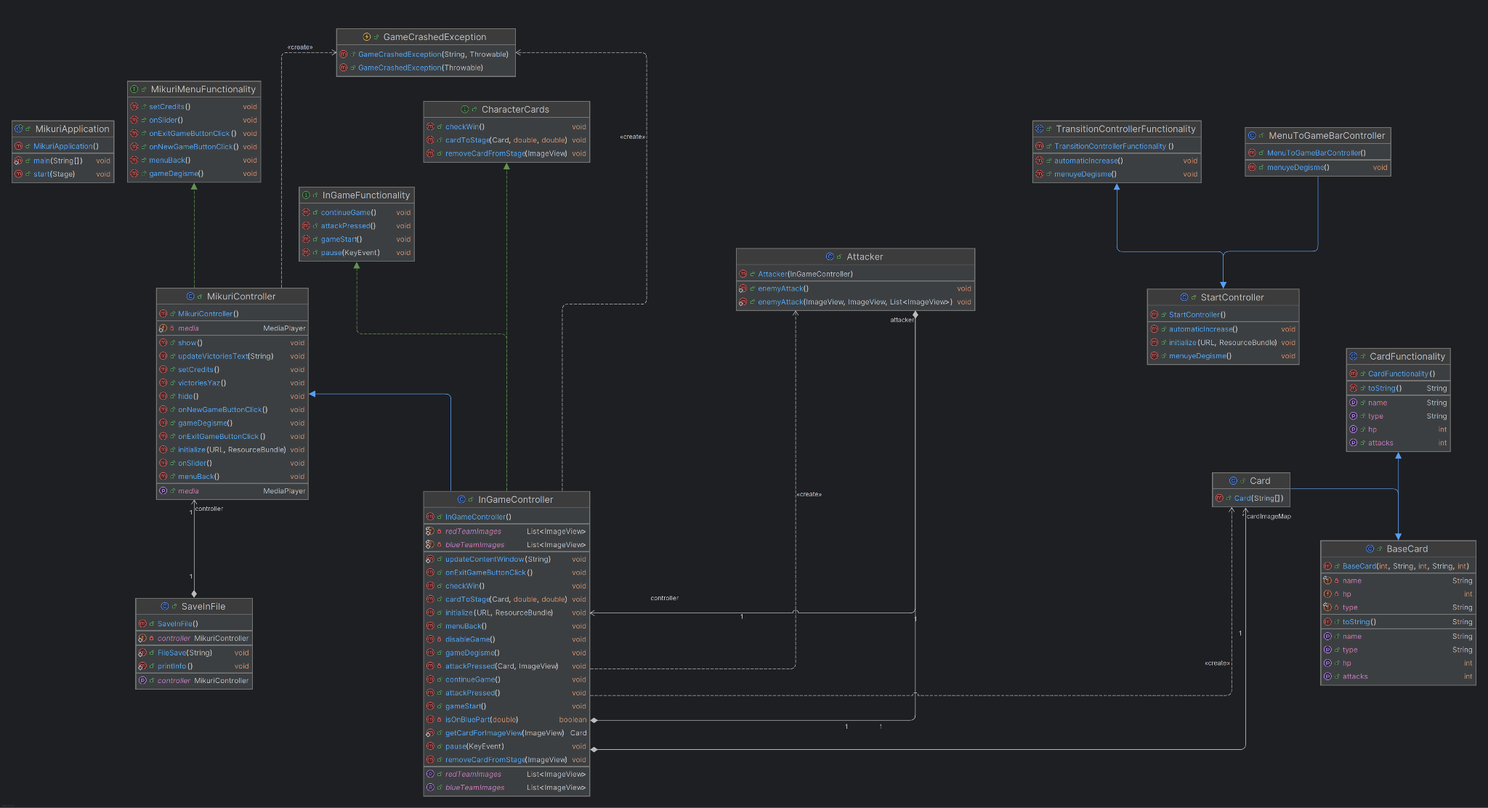
4) Architecture of the Game
9 Classes, 2 Abstract Classes, 3 Interfaces, 1 Exception

Slide 7
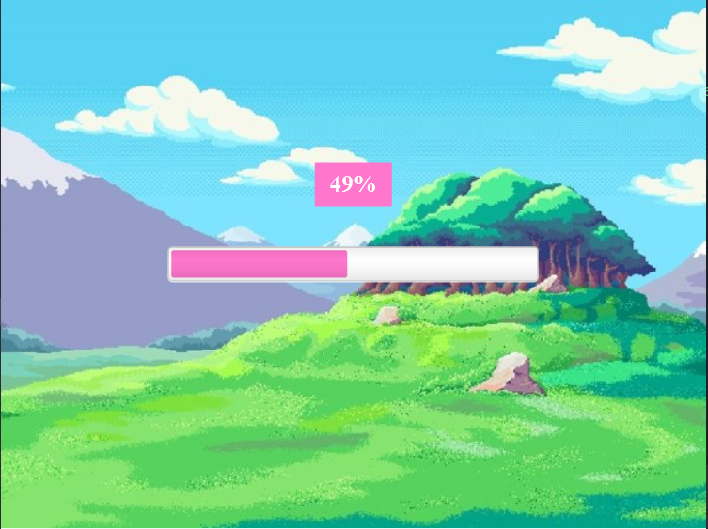
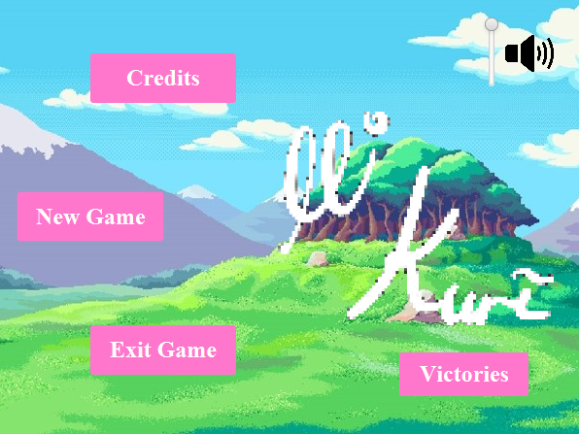
5) Technical Structure and Working Logic of the Game
MikuriApplication runs first to start the game.
Then StartController is run and the loading screen appears.
Finally, the main menu is loaded and the main menu becomes functional according to the MikuriController class.
The main menu contains 5 important elements:
Credits, New Game, Exit Game, Victories, Volume Slider.

Slide 8
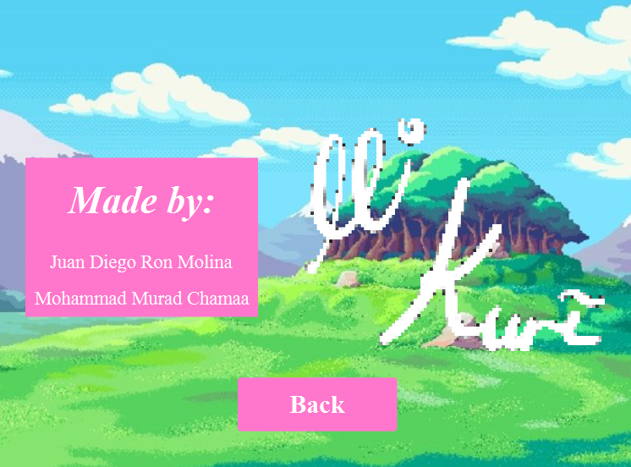
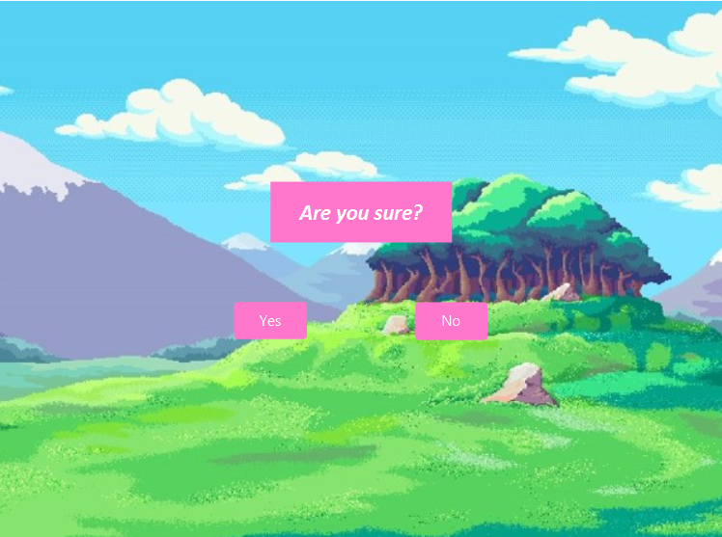
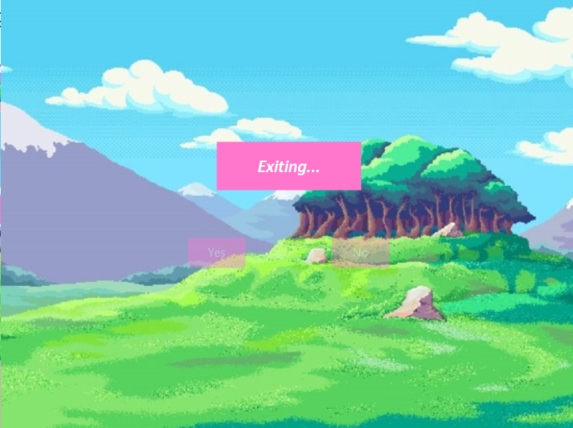
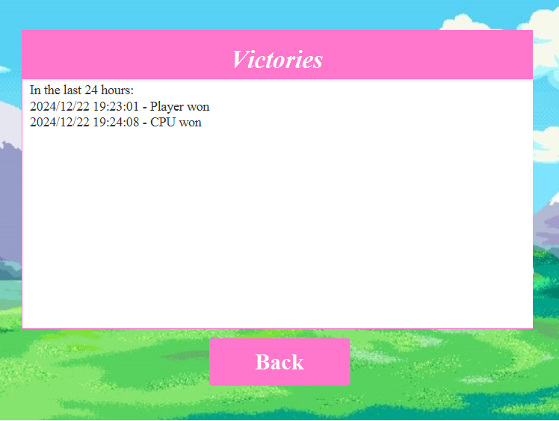

Credits: Shows the game creators.
Exit Game: After initially asking "Are you sure?", pressing the yes button exits the game, pressing the no button returns to the main menu.
Volume Slider: Adjusts the volume of the game music.
Victories: Shows who won the games at what time.

Slide 9
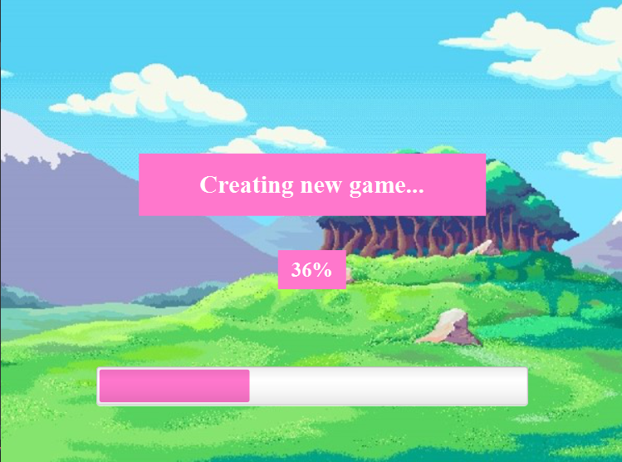
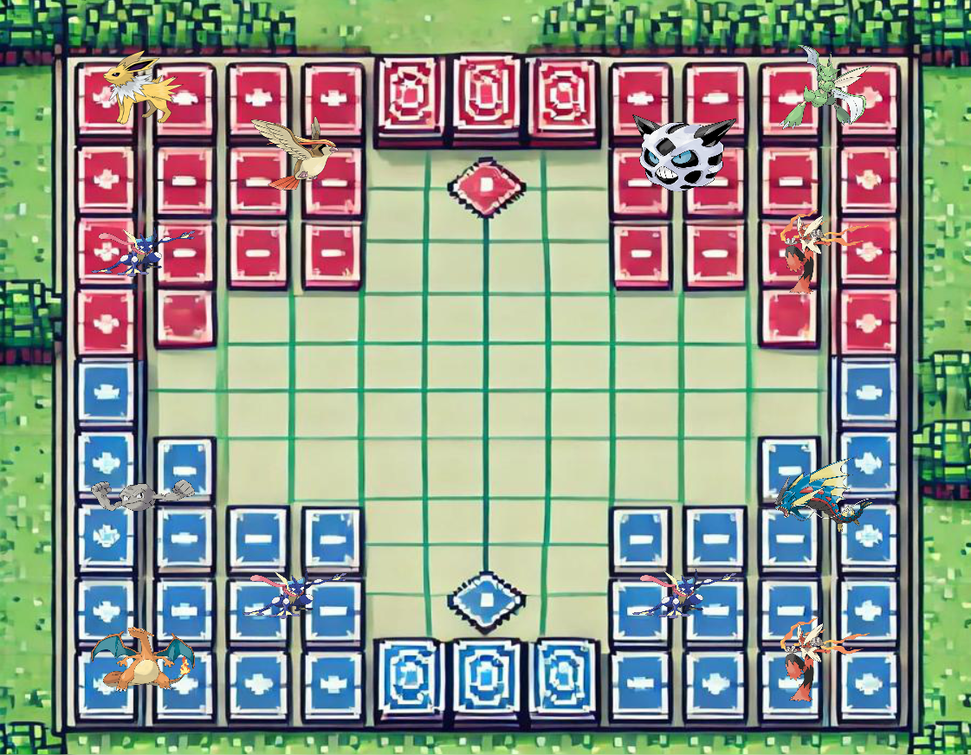
New Game: It displays the loading screen before starting a new game, then starts a new game.
When the in-game screen is loading, the mini monsters are loaded first, then these monsters are transferred to the blue or red teams according to their location. In this way, the first stage of our game is loaded.
In this game, we play the blue team, while the CPU (i.e. the computer) plays the red team. The monsters on the blue side are selected and the monsters on the red team are attacked. If a Pokemon's health drops to zero or lower, the monster is destroyed, if all the monsters of one side are destroyed, that side loses.

Slide 10
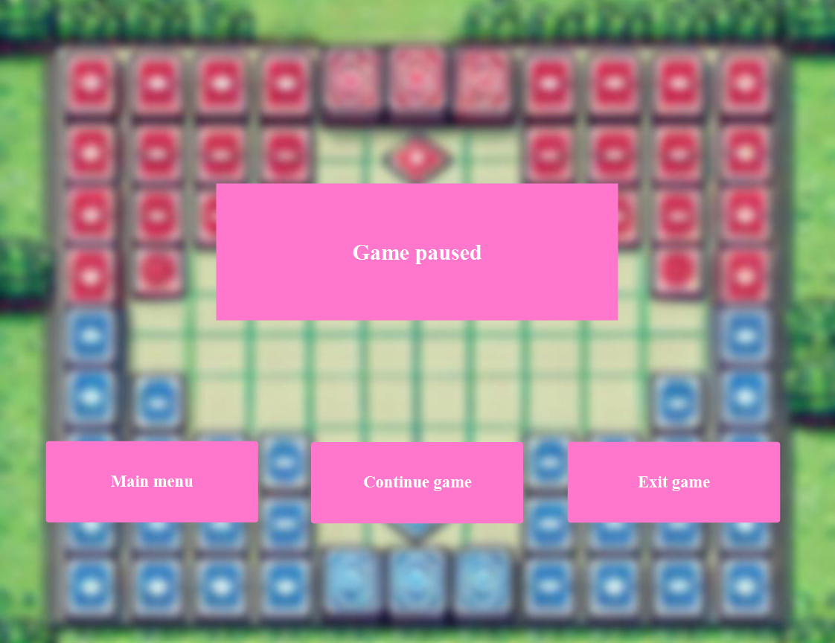
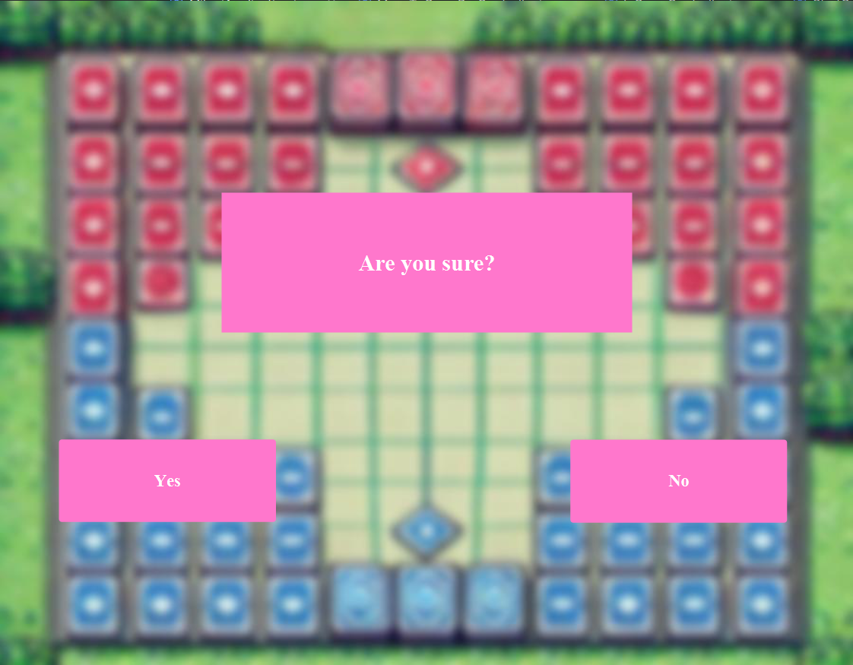
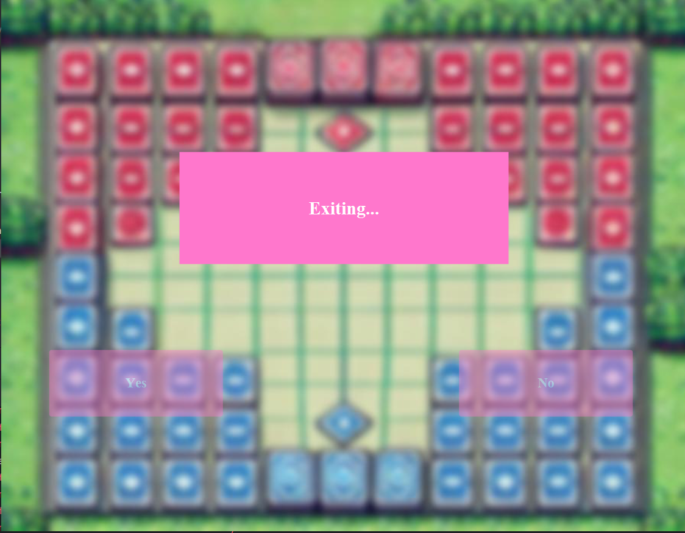
If you press the ESC key, the game will be paused. Here, the pause menu will appear.
If you press the main menu button, it will take you to the main menu.
If you press the continue button, it will return to the game.
If you press the exit button, it will ask "Are you sure?" and then press the yes button, it will exit the game, and if you press the no button, it will return to the main menu.

Slide 11
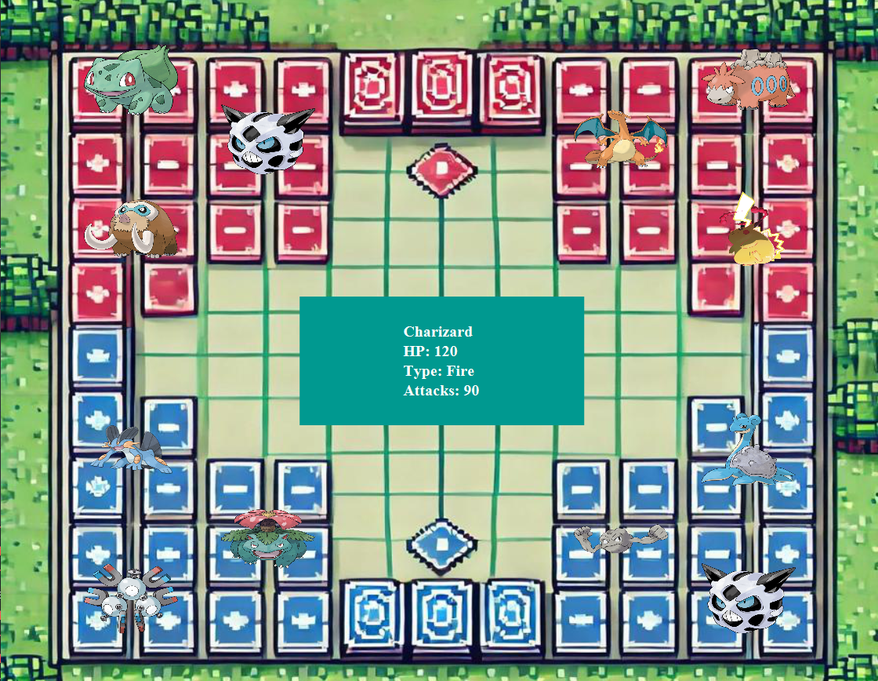
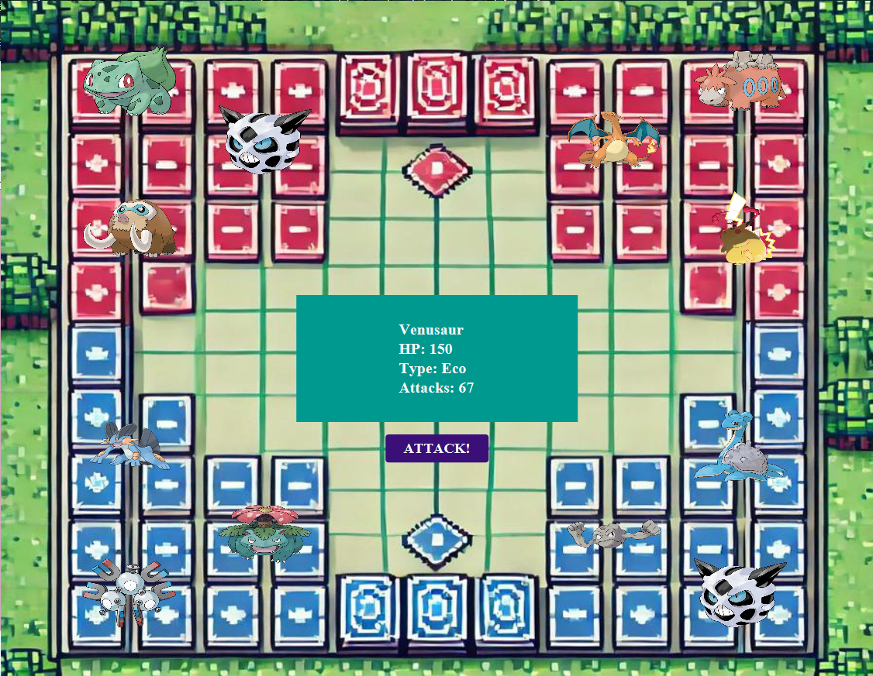
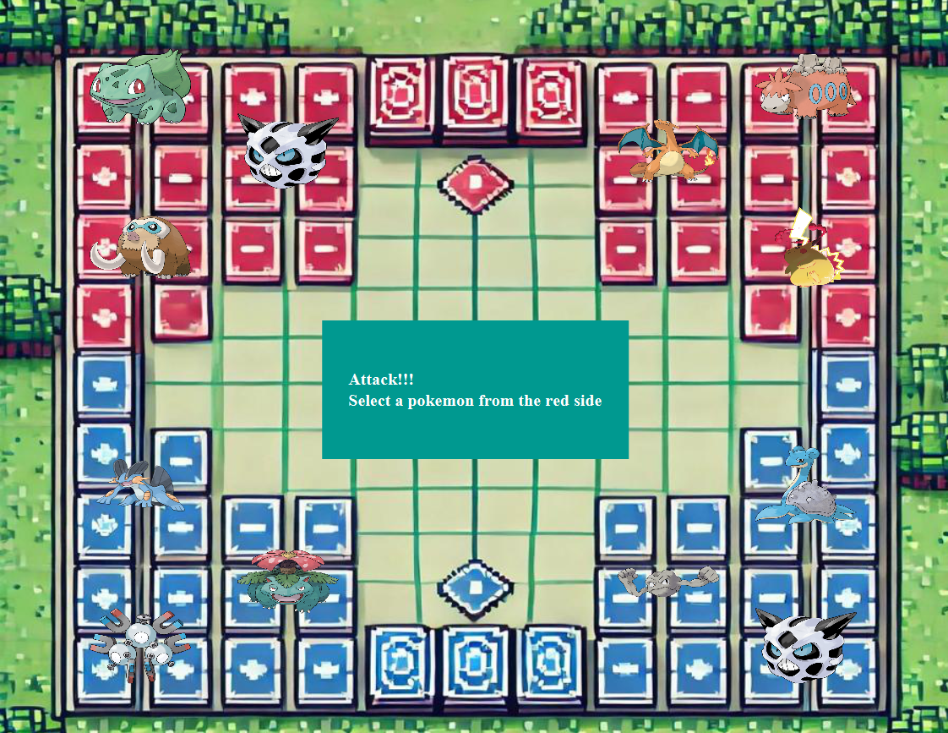
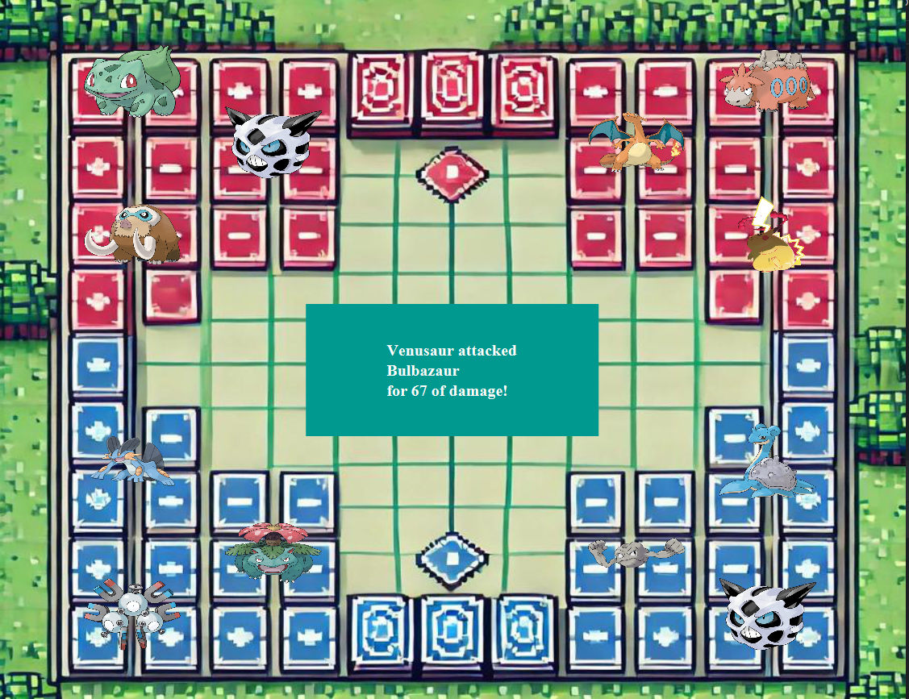

If you click on one of the monsters on the red side, only the features of that monster will be visible.
If you click on one of the monsters on the blue side, both the features of that monster will be visible and the button that you can use to attack with that monster will appear. If you click on the attack button, a monster from the opposite side will be selected and that monster will be damaged.
After making the attack move, the turn passes to the opposing team. Since the red team is the computer, the computer selects a monster from its own side and attacks one of the monsters on its opposite side after a few seconds. Then the turn passes to the blue team.

Slide 12
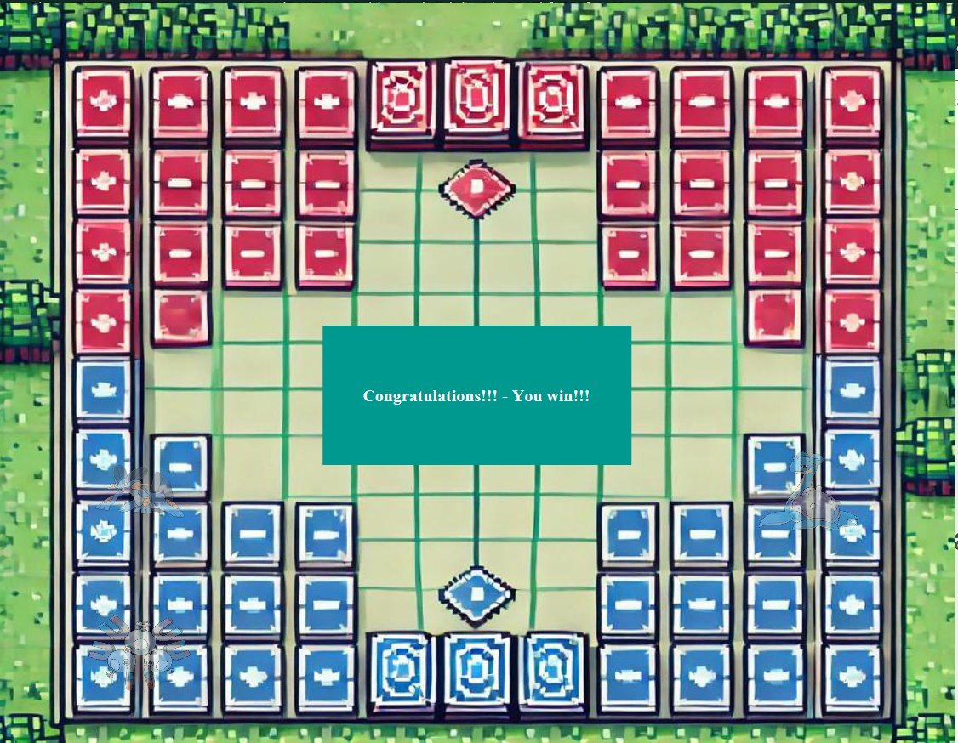
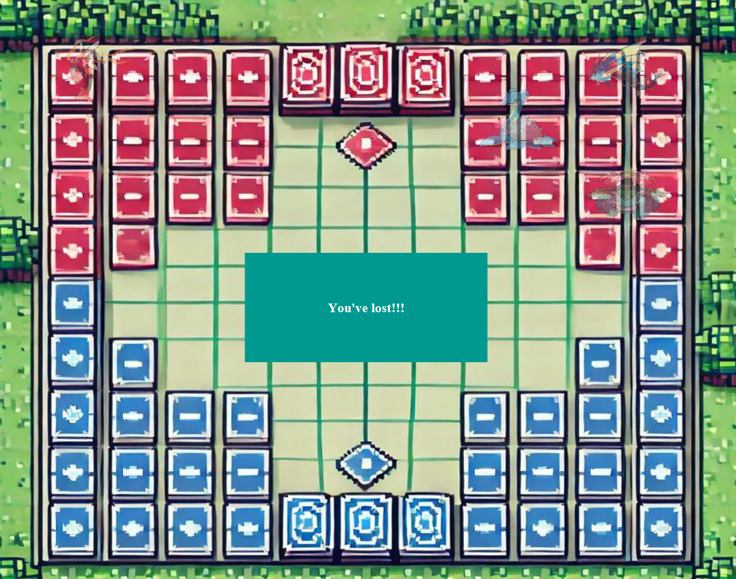
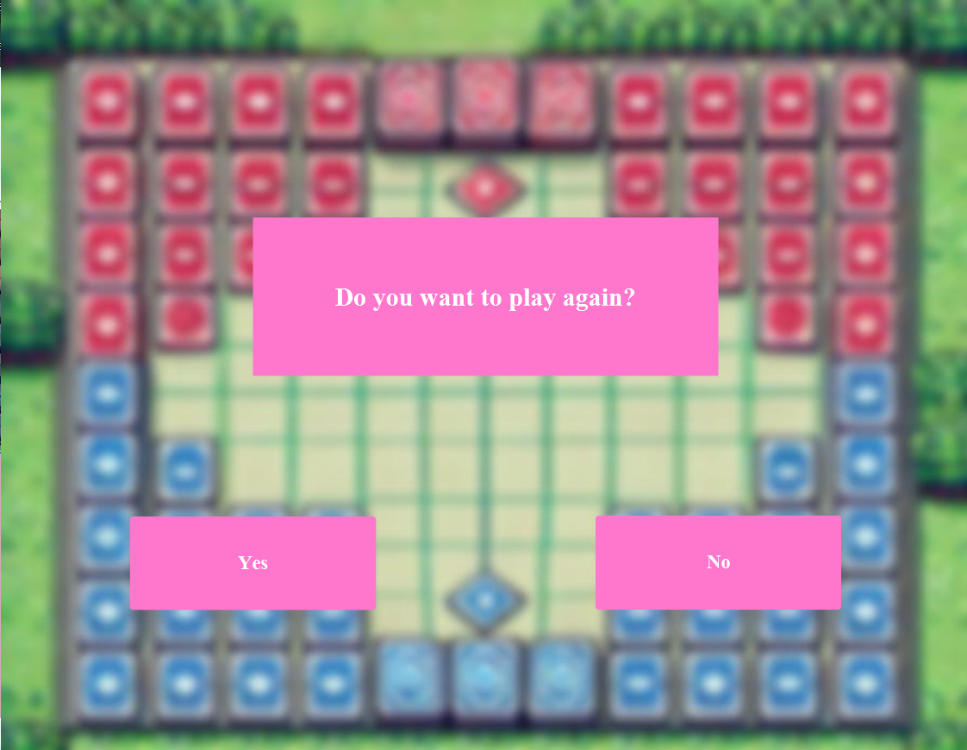
If all the monsters on the red side are destroyed, the winning side will be blue and the screen will print “Congratulations, You Won!”
If all the monsters on the blue side are destroyed, the winning side will be red and the screen will print “You Lost!”
The result of the game will be saved to a file and this file can be viewed from the Victories section on the main menu.
A few seconds after the game is over, a menu will appear on the screen. If you say yes to the question “Would you like to play again?” a new game loading screen will appear, if you say no, you will return to the main menu.

Slide 13
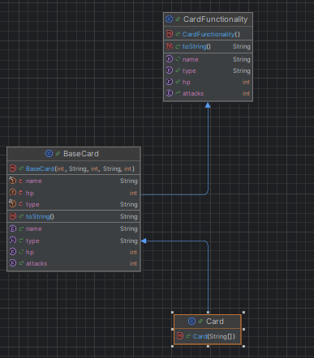
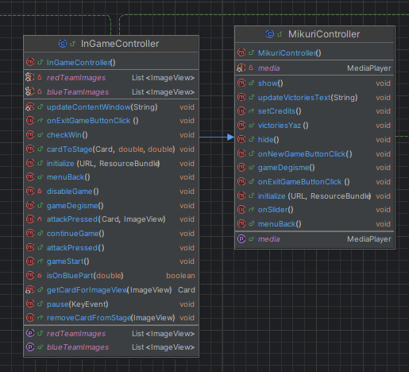
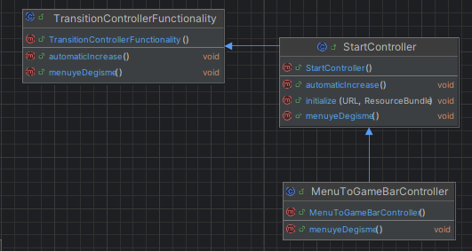
6) Nesne Yönelimli Programlama Özelliğinin Kullanıldığı Yerler
Inheritance
Here, the abstract classes TransitionControllerFunctionality and CardFunctionality are inherited twice, while the MikuriController class is inherited once. The reason for inheriting in this way is that some of its methods are wanted to be transferred to other classes.
The is-a relationships of the classes on the side are as follows:
The Card class is a BaseCard, and the Card and BaseCard classes are a CardFunctionality.
The MenuToBarController class is a StartController, and the MenuToBarController and BaseCard classes are a CardFunctionality.
InGameController is a MikuriController.

Slide 14
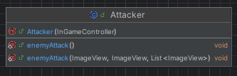
B) Polymorphism
In the first photo, the enemyAttack method is overloaded (static polymorphism). The first method allows the computer to attack the player, while the second method controls the results of this attack.
In the second photo, the InGameController class has overridden many methods from the MikuriController class (dynamic polymorphism). The reason for overriding these is that although they do the same job, their menus are different from each other.
In the third photo, the menuyeDegisme method is overridden twice, while the automaticIncrease method is overridden once. There is no need to override the automaticIncrease method in the MenuToBarController class again, because it can do the same job under the same conditions.

Slide 15
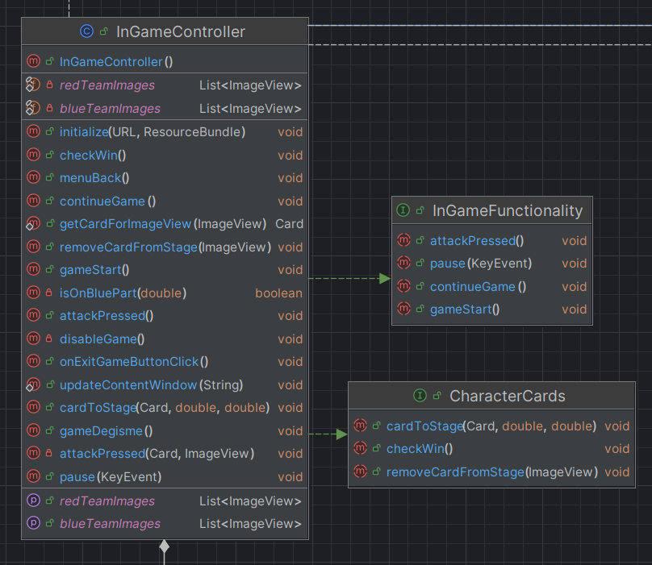
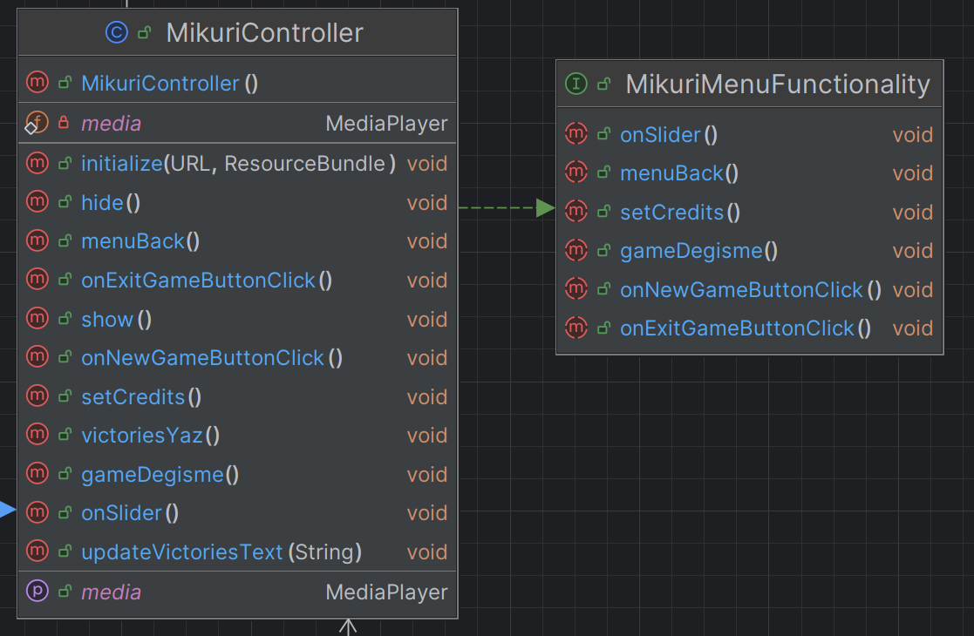
C) Abstraction
Since the TransitionControllerFunctionality and CardFunctionality classes are not written to create objects, they are defined as abstract.
Objects cannot be created from the interfaces on the side. Also, the classes that implement them (implement them themselves) must use the methods included in the interfaces. The reason is that the methods defined in them are defined abstractly.

Slide 16
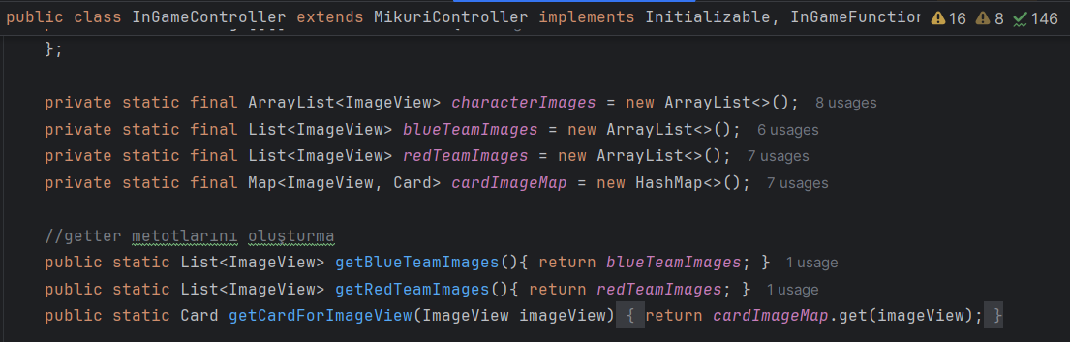
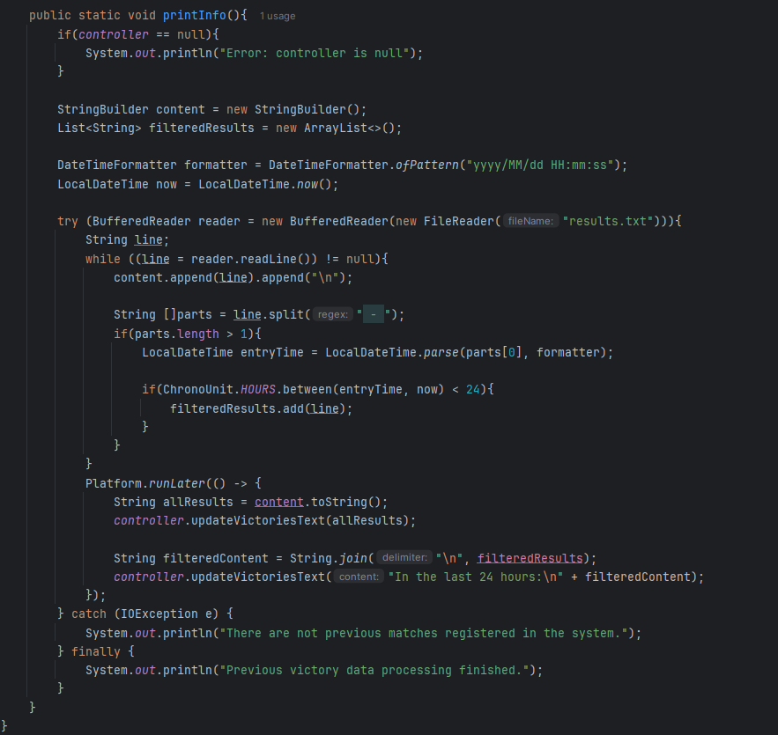
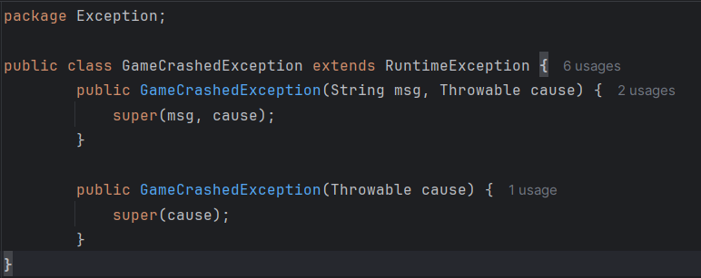
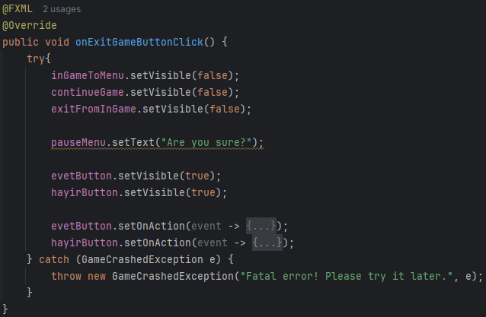
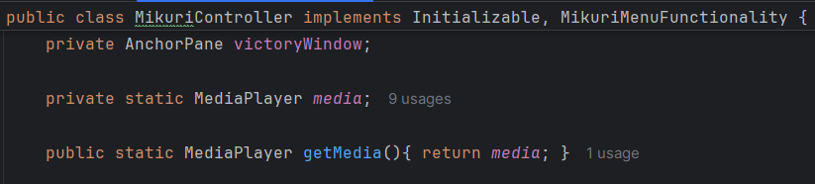
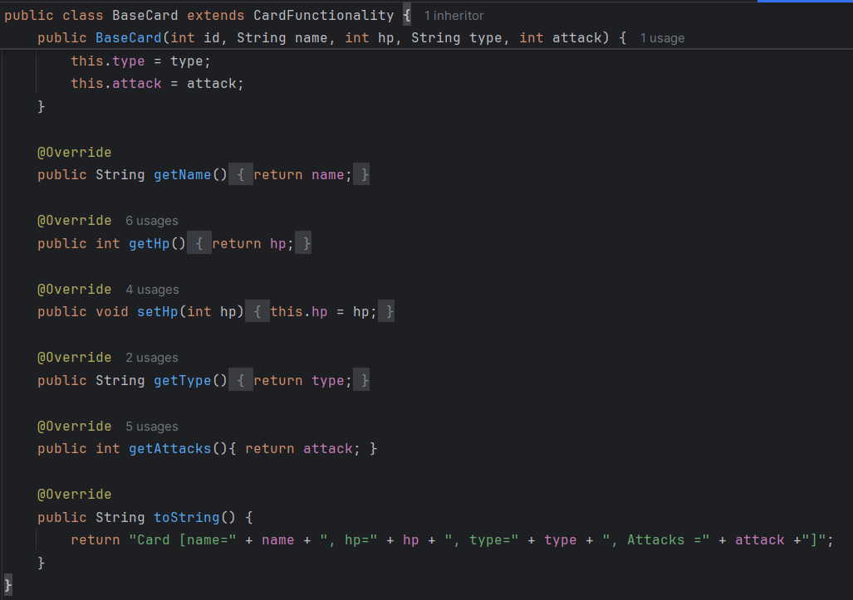
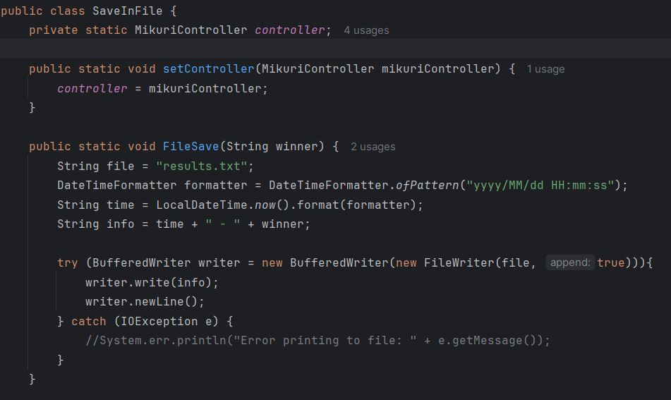
D) Encapsulation
All areas in this game are defined as private for protection purposes. If any changes are to be made in it, it must be called and made with the getter and setter methods.
E) Others
GameCrashedException exception is defined for game errors.
Both date and time and file operations are used in the SaveInFile class.
HashMap is created in the InGameController class to connect images to an object, and ArrayLists are created to save images according to teams.

Slide 17
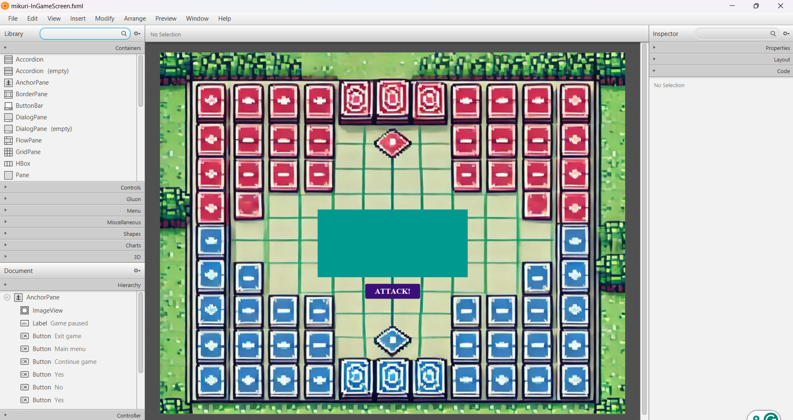
7) Difficulties Experienced and Solution Suggestions
There were a few problems with using JavaFX, especially since we had never used this library before, we had difficulties in making a game with this library. That's why we first took JavaFX training and things were made easier with SceneBuilder.
It took us a long time to place the monsters on the stage. After many unsuccessful attempts, the solution was to first save the monsters' information in the ArrayList array one by one with a for loop, then assign them to another method with a for loop and put them on the stage according to the teams.
We encountered many problems both in the production and finishing stages of the game. The bugs that took the most time were these problems. As a solution, most of these problems were solved by testing our game.

Slide 18

8) Conclusions and Recommendations
This experience was extremely valuable for us. Learning a library that we had never known before and developing a game using this library was a challenging but enjoyable process.
Although Java is a bit more complex than other programming languages, it offers an effective alternative for game development thanks to the flexibility and strong infrastructure it offers with its Object Oriented Programming (OOP) approach.
As you develop a complex application in Java, you better understand the subtleties and capabilities of the language. For this reason, we recommend that you implement a complex project such as a game using Java. This process will provide great benefits in terms of both technical and personal development.

